Slide 1
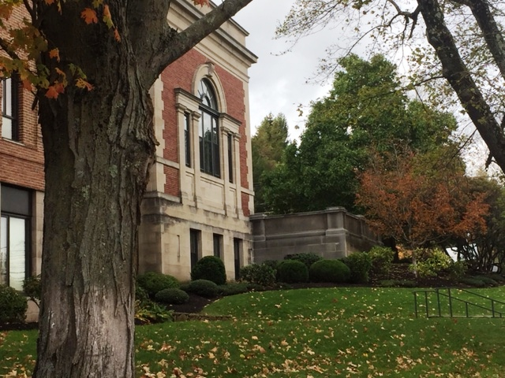
Milton Public Library
FY20 Budget Presentation
Warrant Committee Meeting
Monday, February 4, 2019

Slide 2
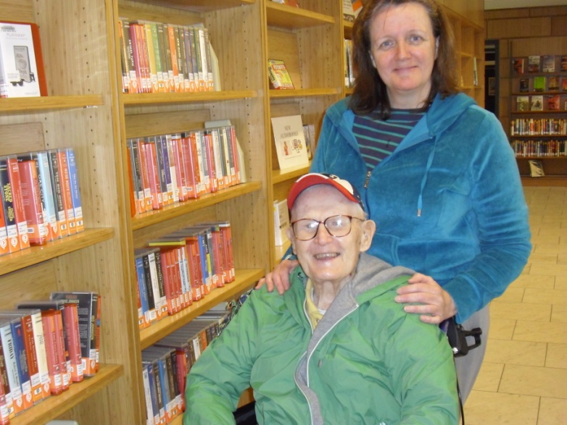
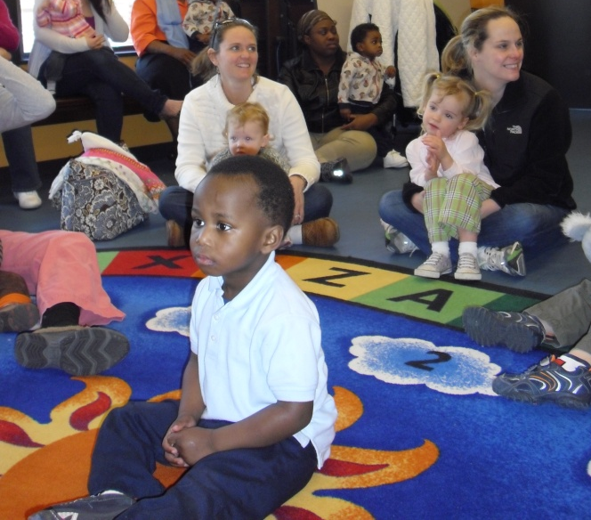
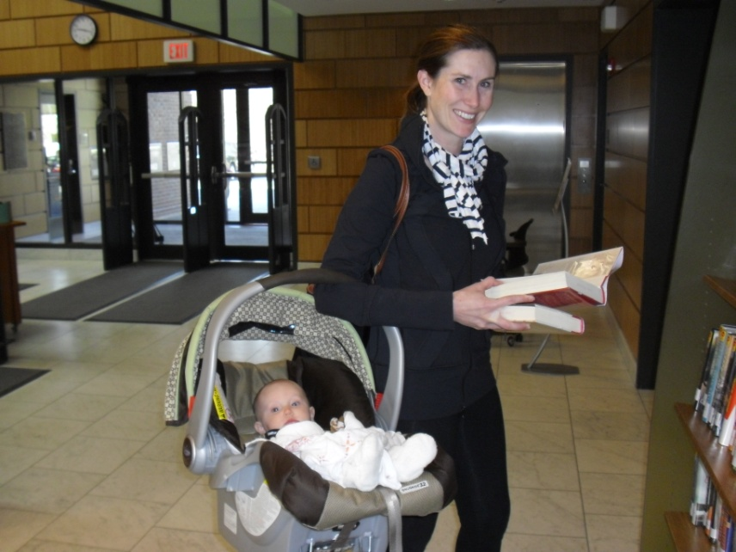
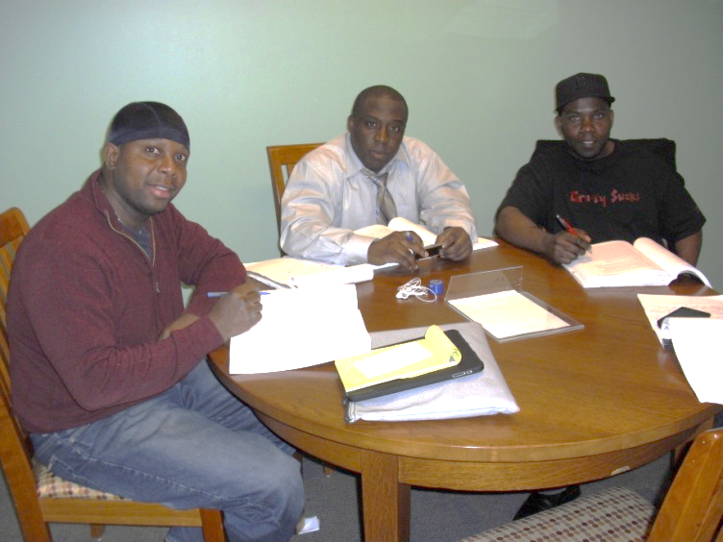
The Library - A Vital Part of Our Community
Notes:
I want to start with a brief introduction about our Library. The MPL serves our entire community. We see many different faces every day, and we see some of the same faces several times a week.

Slide 3
The Library Is . . .
Free to All
Serving the Entire Community: toddlers, caregivers, tweens & teens, students and adults, seniors
Everywhere: Main Library, online, in schools, Fuller Village, Farmers Market, Little Free Libraries
Notes:
We start out in the Library sitting in our parents laps; we return to get ready for school; we come for school projects or afterschool; we use it on college breaks; we return again when we are older, maybe with kids of our own; and we continue to use the library for recreation or continuing ed for years to come
We are everywhere

Slide 4
Key FY18 Library Metrics
 | FY14 |  | FY18 | Growth
Downloads | 18,840 | vs. | 59,807 | 217.4%
Programs Offered | 581 | vs. | 662 | 13.9%
Program Attendance | 13,537 | vs. | 17,446 | 28.9%
Reference Questions | 14,556 | vs. | 44,980 | 209.0%
Notes:
Five year table
82 downloads a day
2 programs a day
48 people per day at programs
123 information questions answered each day
Lean – 1/3 checkouts are self service
Complexion of services is changing
National averages – we are seeing more growth as compared to other members of OCLN and the national average.

Slide 5
Recent Improvements
Space Planning implementation
Two new quiet study rooms
Two new semi-private study areas
Revitalization of the Café area, including five new study pods
Replaced lower level/stairwell flooring
Sealed Library Parking Lot
Expansion of online services
More dedicated funding for eBooks and eAudiobooks
Introduced Pronunciator (language learning), Niche (video tutorials), Lynda.com (career/IT videos)
Technology training for staff and residents; including device training and training on Library services
Notes:
Facilities/services balance
Public/Private partnership
MLF funded projects
Capital projects
Trustee projects

Slide 6
Current Challenges
Current funding does not allow us:
To provide adequate eBook training and other Library workshops
To meet the attendance demands for story times
To meet the full potential of our facilities
To provide adequate teen services
To meet the current demands for new books
To fund two positions approved by the Personnel Committee

Slide 7
How We Compare
Town | Population | Annual Hours | Visits | Program Attendance | Room Use
Belmont * | 25,584 | 3,239 | 268,997 | 17,904 | 878
Canton (g) | 22,817 | 2,730 | 137,256 | 10,111 | 2,016
Hingham * | 23,120 | 2,731 | 246,827 | 19,343 | 4,408
Milford (p) | 28,614 | 3,284 | 130,580 | 12.054 | 1,367
Milton | 27,374 (5) | 3,114 (7) | 215,632 (5) | 17,446 (4) | 1,111 (6)
Randolph (g) | 33,699 | 3,328 | 189,820 | 17,059 | 1,660
Stoughton (p) | 28,431 | 3,128 | 98,343 | 13,297 | 64
Wellesley (p) | 29,000 | 3,365 | 361,162 | 34,930 | 3,176
Winchester * | 22,417 | 3,179 | 239,047 | 14,150 | 797
* - Model Library
g - Geographic
p - Population
Notes:
() = ranking as compared to these libraries
Middle or better in usage statistics

Slide 8
How We Compare
Town | Circulation | Holdings | FTE | Per Capita Operating | Appropriation
Belmont * | 595,286 | 209,921 | 26.51 | $86.97 | $2,224,945
Canton (g) | 250,549 | 214,356 | 17.00 | $50.99 | $1,163,512
Hingham * | 364,893 | 214,014 | 24.63 | $71.25 | $1,647,409
Milford (p) | 183,377 | 230,676 | 20.23 | $43.53 | $1,245,517
Milton | 329,505 (5) | 169,382 (7) | 18.40 (6) | $58.25 (5) | $1,448,495 (5)
Randolph (g) | 180,918 | 96,598 | 13.46 | $31.85 | $1,073,268
Stoughton (p) | 151,220 | 107,954 | 16.44 | $37.03 | $1,052,874
Wellesley (p) | 899,078 | 362,261 | 36.24 | $94.05 | $2,727,576
Winchester * | 508,867 | 197,893 | 24.94 | $84.77 | $1,900,374
* - Model Library
g - Geographic
p - Population
Notes:
FY15
Middle or better in usage statistics
We are in the bottom half for staffing and funding
Canton – we have higher usage stats, with less staffing and less funding

Slide 9
How We Plan
The Library has used historical data and a strategic planning process to anticipate demands for Library services
Annual Data Survey provided to MBLC
Five Year Financial Forecast
Library Long Range Plan FY17- FY21
Early Literacy
Lifelong Learning
Stimulate Imagination
Connect to the Online World
Visit a Comfortable Place – Physical & Virtual

Slide 10
Library Budget Factors
State Aid Requirements
Municipal Appropriation Requirement
Includes appropriations
102.5% higher than average of previous three years
$1,452,692
Materials Expenditure Requirement
13% of combined appropriations and revolving to be spent on materials
Materials can be books, DVDs, eBooks, databases
Requirement can be met through appropriations and revolving accounts
$196,099

Slide 11
Factors Affecting FY20 Library Budget
Materials Revolving Fund
Continued decrease in revenue since FY13
Notes:
65603
59941
55830
52704
48977

Slide 12
FY20 Budget
This Budget WILL:
Maintain the status quo
This Budget will NOT meet all current demands, such as:
Training and technology assistance
Waiting lists for story times and other children’s programming
Programming to meet current demand
Waiting lists for school visits
Waiting lists for off site book discussions and technology training
Wait times for eBook and print circulation

Slide 13
Thank you
Presentation prepared by:
William Adamczyk, Library Director
The Board of Library Trustees:
John Folcarelli, Chair
Hyacinth Crichlow
Raymond Czwakiel
Philip Driscoll
Chiara Frenquellucci
Paul Hays
Kristine Hodlin
Kari McHugh
Sindu Meier

